Slide 1

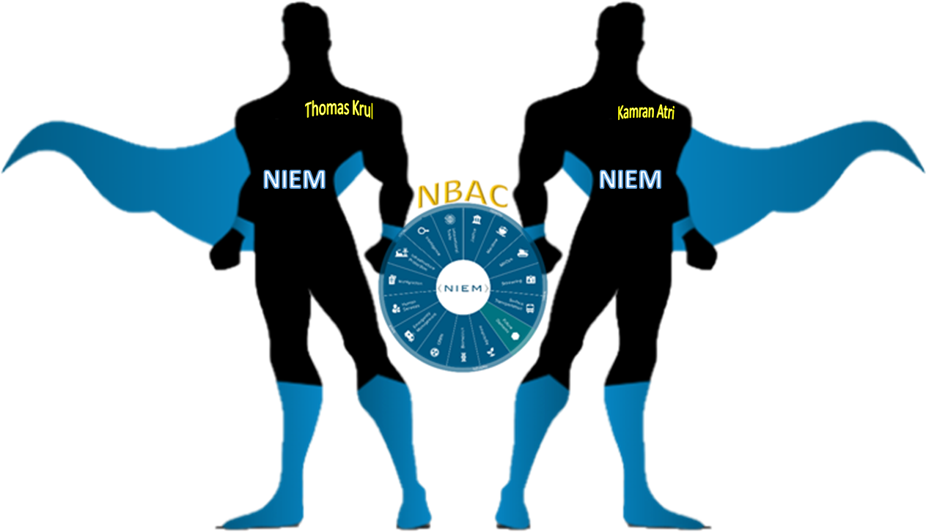

NIEM F2F Plenary Session 2021
NBAC 2021/2022 Workplan

Slide 2
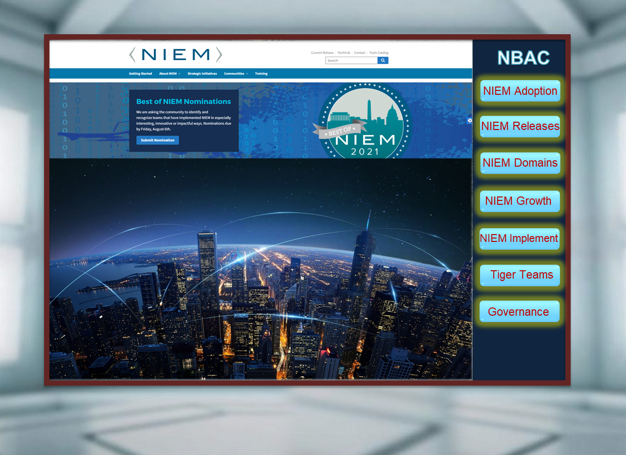
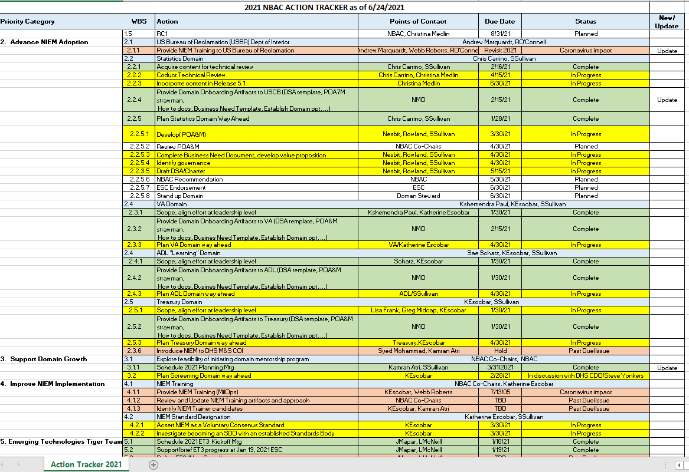
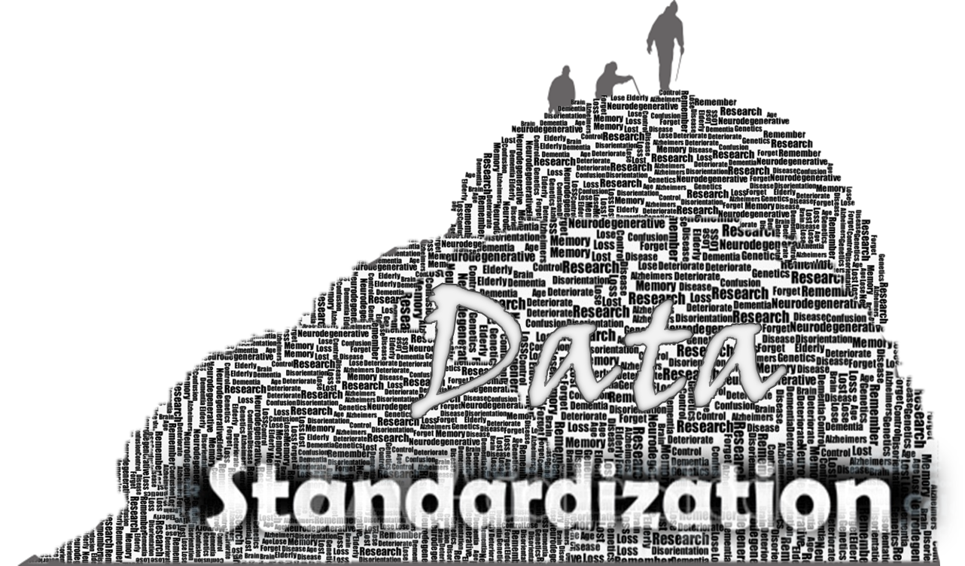

NBAC 2021 / 2022 Priorities / Work Plan
NBAC Action
Tracker
Onboarding / Maturing Domains
Mentoring Program
Leveraging Tiger Teams
Internationalization
State, Local, Tribal, Territorial
NIEM as a Standard
Training Offerings
…
Continue adding/maturing NIEM Domains Content …
Onboarding
VA Domain

Slide 3
2021/2022 Work Plan (Cont.)
Future NIEM Release Plan … 5.2
… Census (Statics Domain), ADL (L&D Domain), Biometrics Domain, Cyber Domain, EM Domain, MilOps Domain
NIEM Documentation Review (Governance and Process) as we move to tag NIEM as a Data Standard Organization
PMO, NBAC or NTAC Charters and Governance Documents
NIEM Openness / Transparency
Are there any Barriers to Participation
What are NIEM Voting and Decision-making process
What are the NIEM Membership Requirements (for Gov and non-Gov organizations)
What are the Technical Qualifications for joining NIEM
What are NIEM Objection process in accessing documents or Evaluating new content
What is NIEM Appeal process for Domain On-boarding, Standard development, or Conflict Resolution
What are NIEM Terms and Conditions regarding Privacy, Patent, Security, Antitrust, Adjudication…
What are NIEM Established and Enforced Processes: Proxy voting, Technical Assistance (i.e. Help desk), Active or Inactive status of standard, Release (emergency or normal)

Slide 4
2021/2022 Work Plan (Cont.)
Internationalization
Language
Invigorating the tiger team (Meetings, charter…)
Which partner do we cultivate next
Tiger team
Way ahead for ET3
NIEM Adoption 2022
VA … USCB …Others
NIEM Training
What would be the NBAC role?
Mentoring Program
Next Steps

Slide 5
2021/2022 Work Plan (Cont.)
2021 Annual Report
Should the NBAC Have a Github Site?
How best to take advantage of Social Media

Slide 6

NIEM Plays a Key Role in:
Designating an Organization as a “ Data Driven Organization ”.
Organizations that must Consume, Access, Manipulate, Manage, Analyze, Standardize, Share and Distribute all Available Data from Existing or New Potential Data Sources.
Data Architecture, Data Management and Data Engineering, the Key Components of any IT Modernization Life Cycle.

Slide 7






Questions?
Enabling Connected Future Now
Thomas Krul
Kamran Atri
Stephen M. Sullivan
thomas.krul@canada.ca
katri@A4SAFE.COM
Stephen.m.sullivan14.ctr@mail.mil
Sullivan_Stephen@bah.com
NBAC Co-Chairs
NBAC Co-Chairs
NBAC Secretariat –NIM PMO

